Slide 1
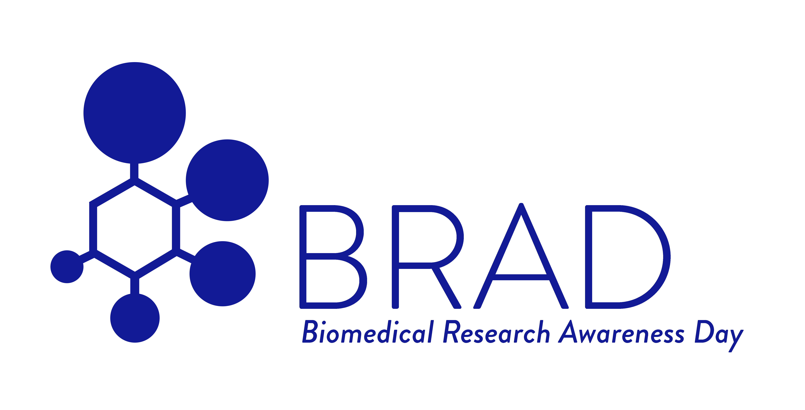
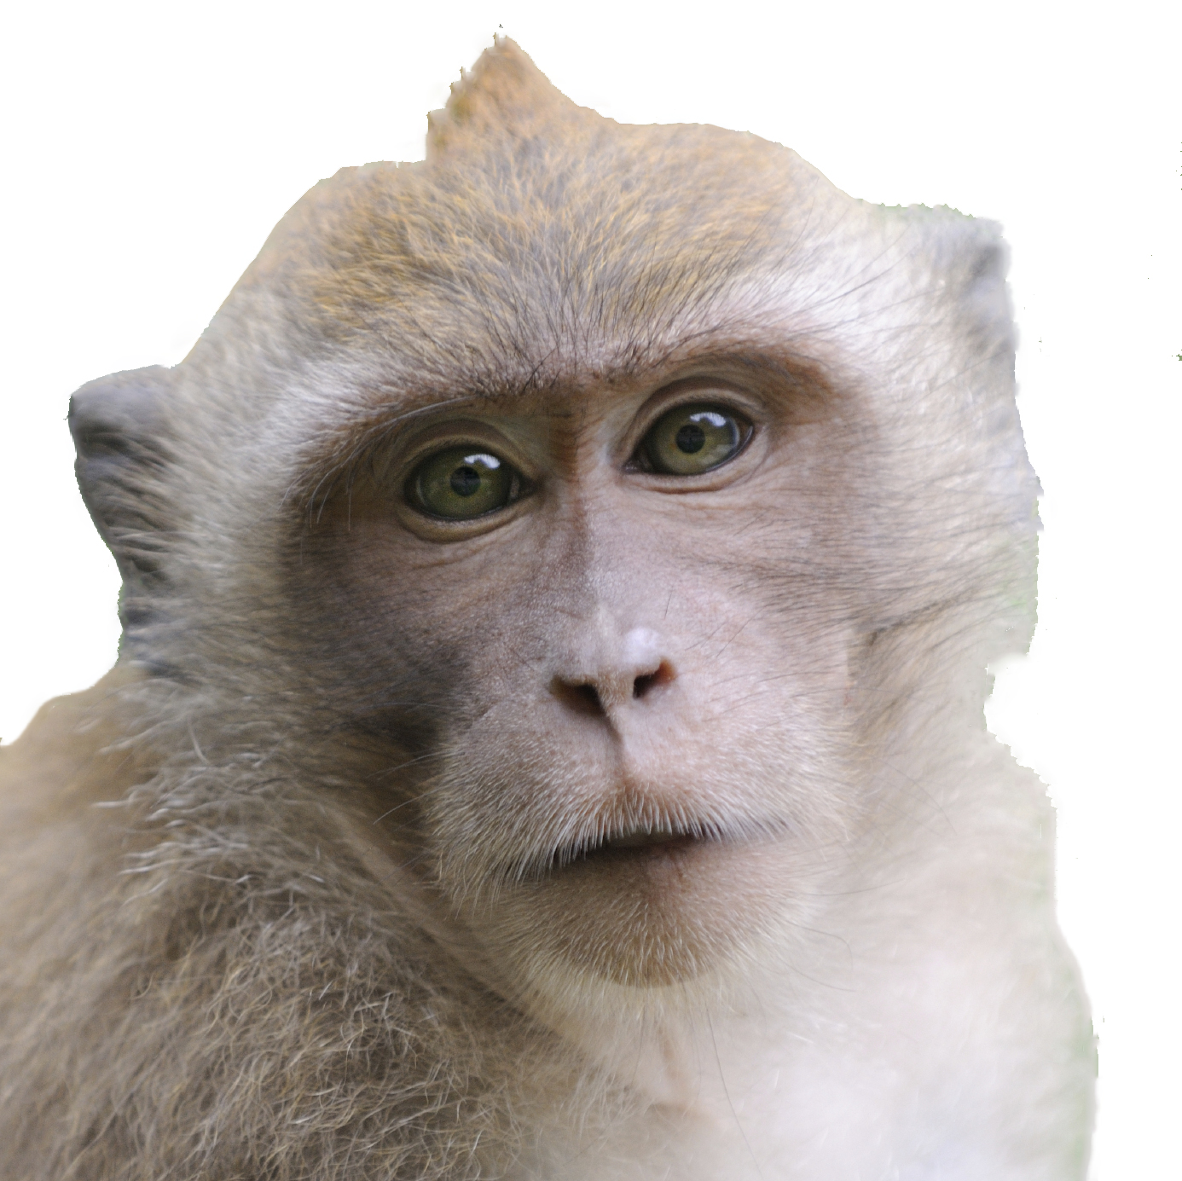
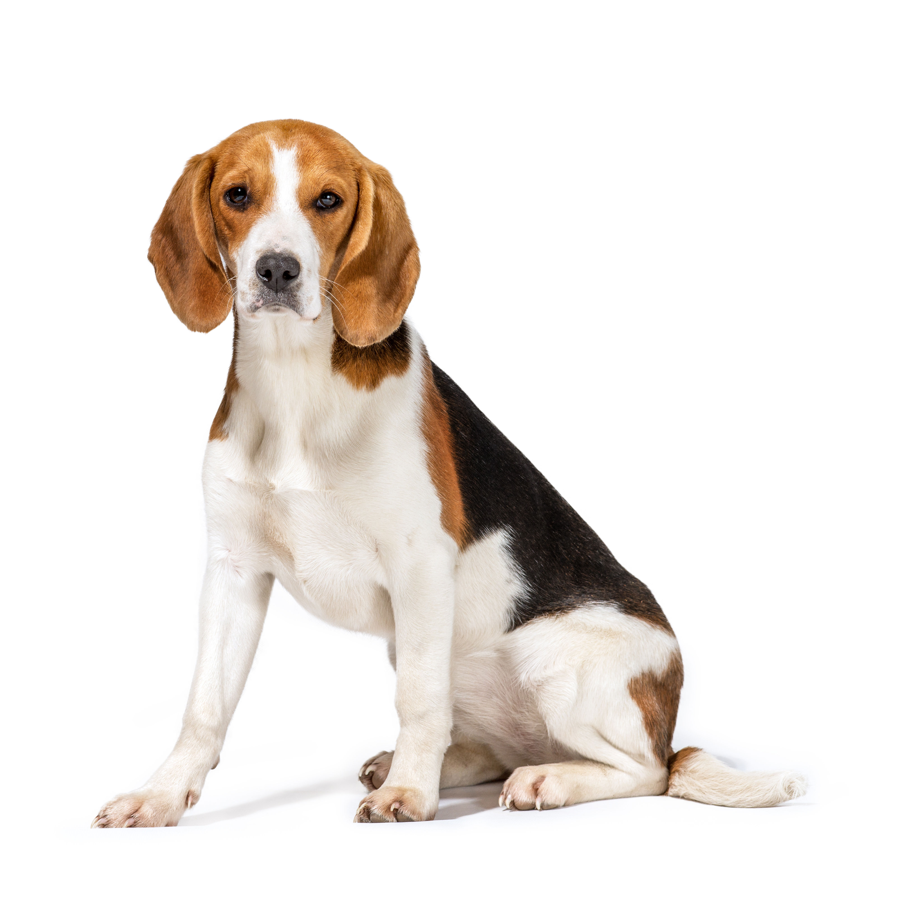
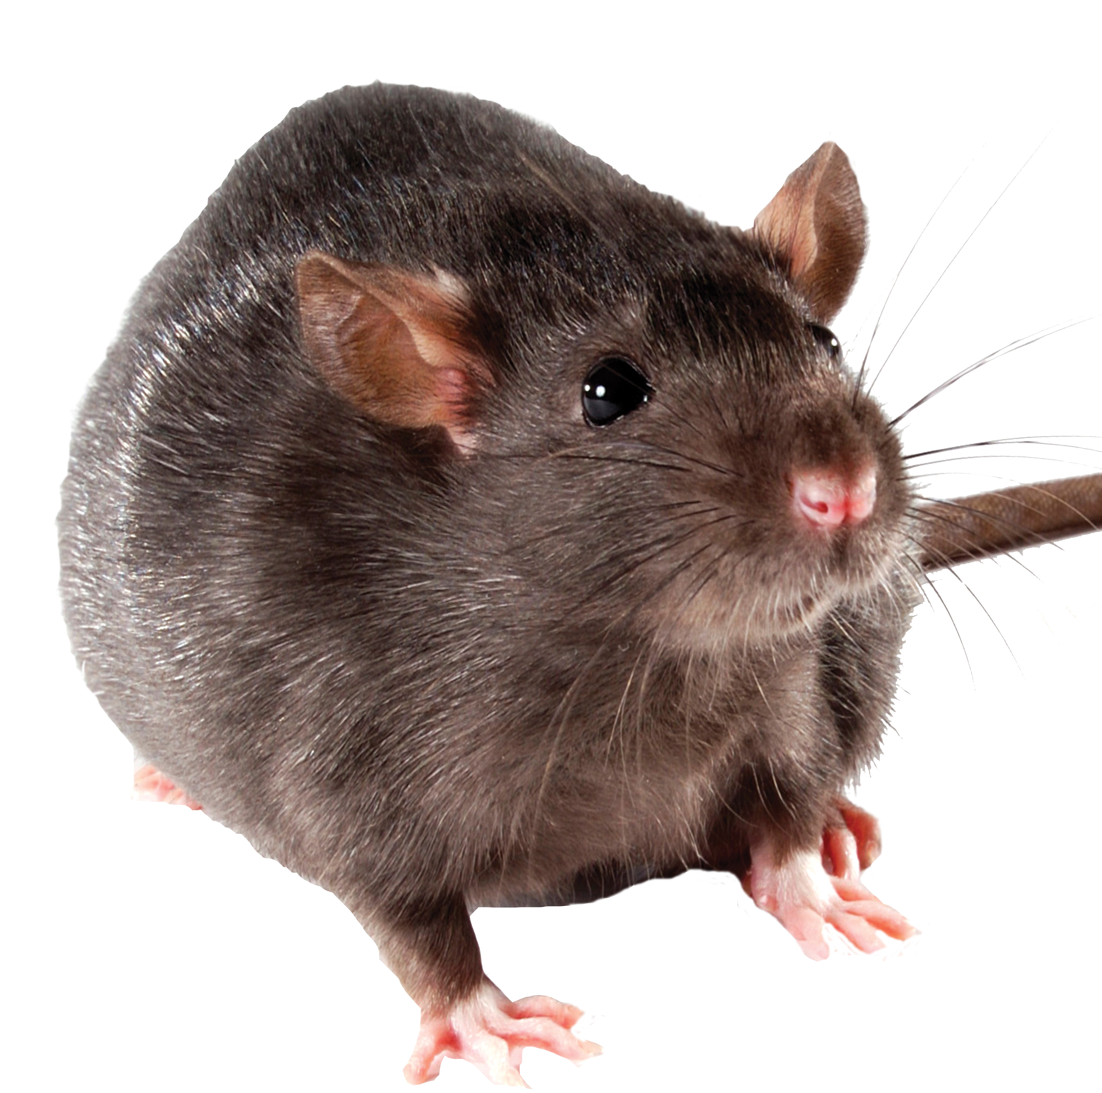
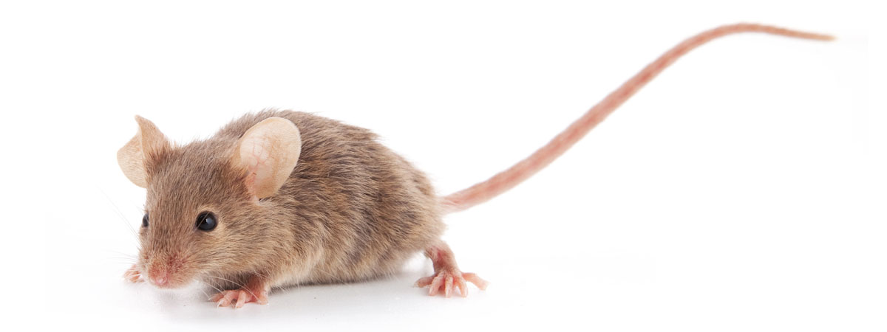
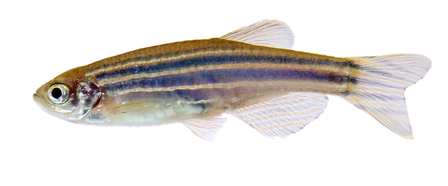
Laboratory Animal Jeopardy

Slide 2
NAME THAT ANIMAL | CARING FOR OUR ANIMALS | DISEASES | CURES | MIXED BAG
200 | 200 | 200 | 200 | 200
400 | 400 | 400 | 400 | 400
600 | 600 | 600 | 600 | 600
800 | 800 | 800 | 800 | 800
1000 | 1000 | 1000 | 1000 | 1000

Slide 3
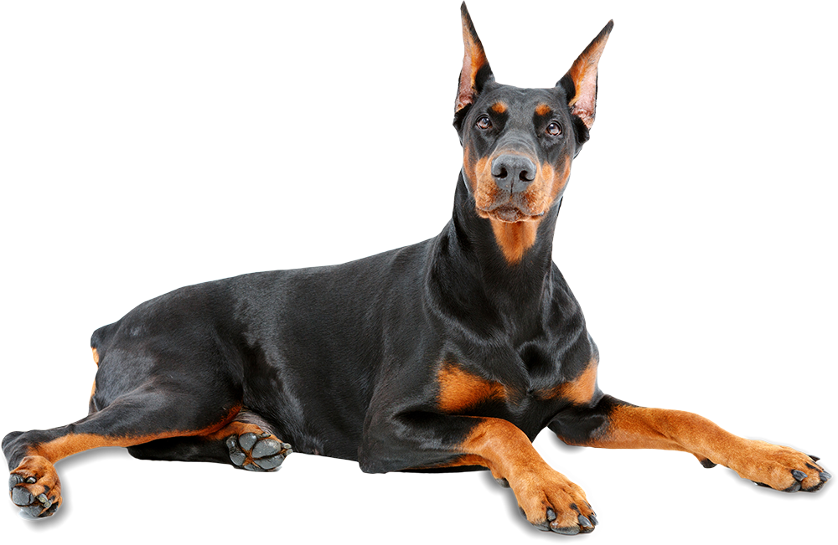

Slide 4
Doberman Narcoleptic Doberman Video
Notes:
Dobermans can have a genetic defect that causes narcolepsy, a disorder that prevents them from controlling their sleep-wake cycles and causes them to lose muscle control and even fall asleep spontaneously. This disorder impacts humans as well, so we can study the condition in dogs. Click the link to see a video of narcoleptic dogs.

Slide 5
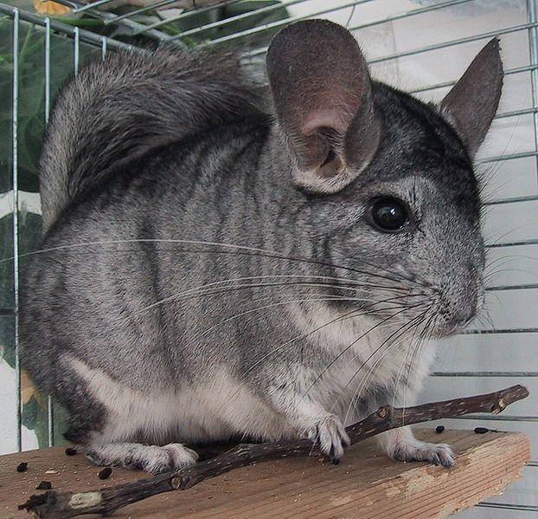

Slide 6
CHINCHILLA
Notes:
Chinchillas and non-human primates are used to study the vestibular system which is responsible for maintaining posture stabilization and spatial orientation/navigation.

Slide 7
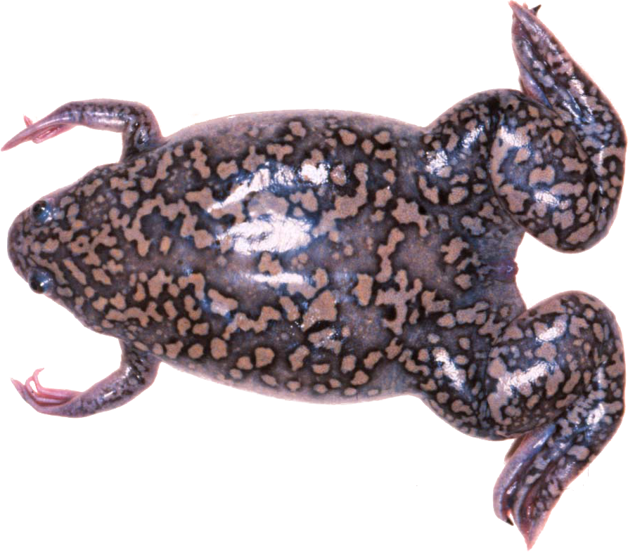

Slide 8
AFRICAN CLAWED FROG
Notes:
African clawed frogs are used for embryology studies and oocyte harvests. They produce eggs year-round, and their embryos are a fantastic model for vertebrate development.

Slide 9
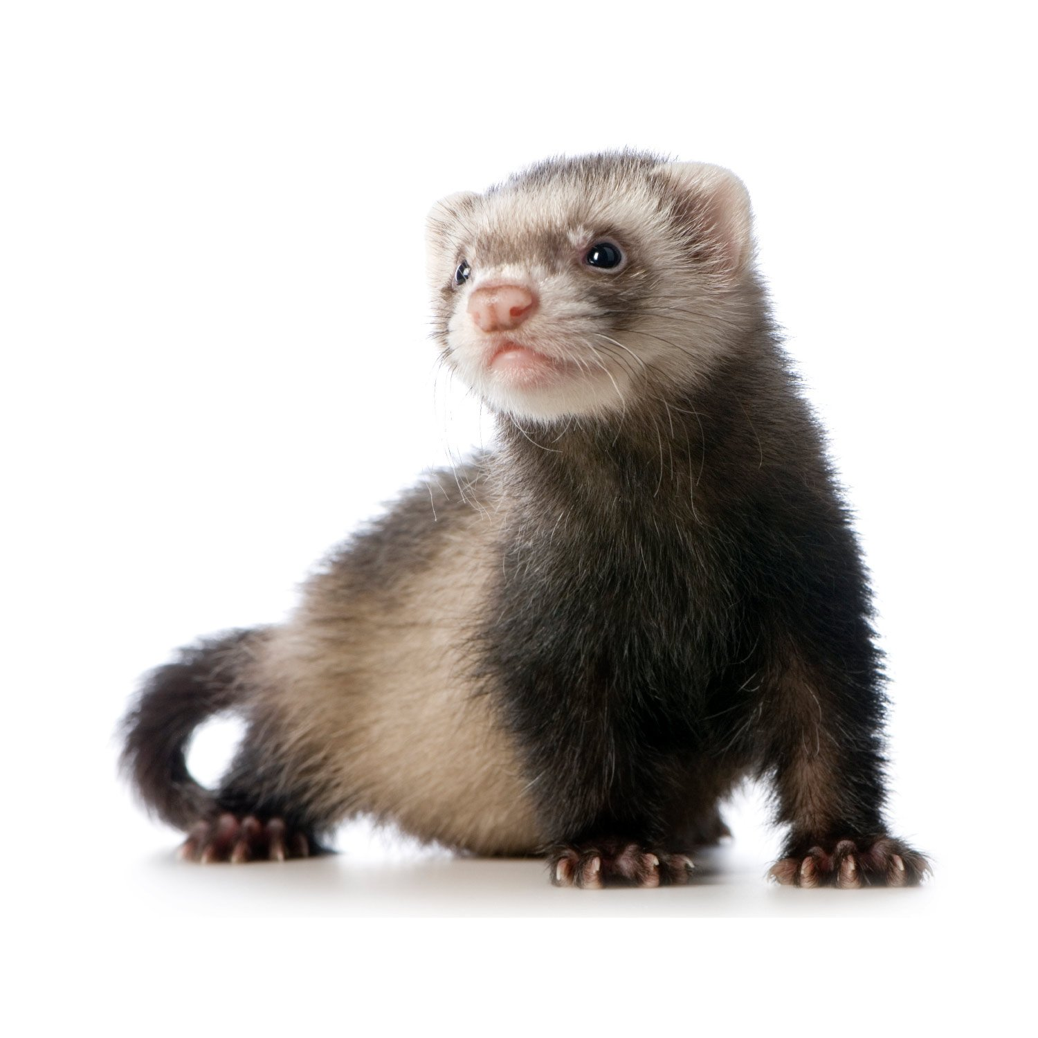

Slide 10
FERRET
Notes:
What is unique about the ferret’s anatomy? They have very long necks and as a result, very long and thin tracheas, which makes them great models of neonatal intubation. They also have large lungs for their body size and are useful for respiratory studies, including influenza.

Slide 11
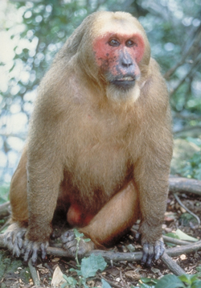

Slide 12
STUMP-TAILED MACAQUE
Notes:
Check out the strange hair pattern on this animal. The stump-tailed macaque is used to study both male and female pattern baldness.

Slide 13
TRUE OR FALSE?
There are laws and regulations in place to make sure animals involved in research are treated humanely.
(Click for more)

Slide 14
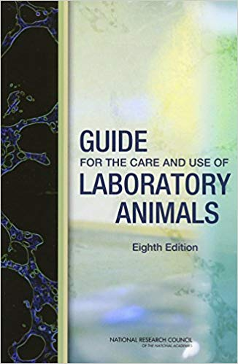
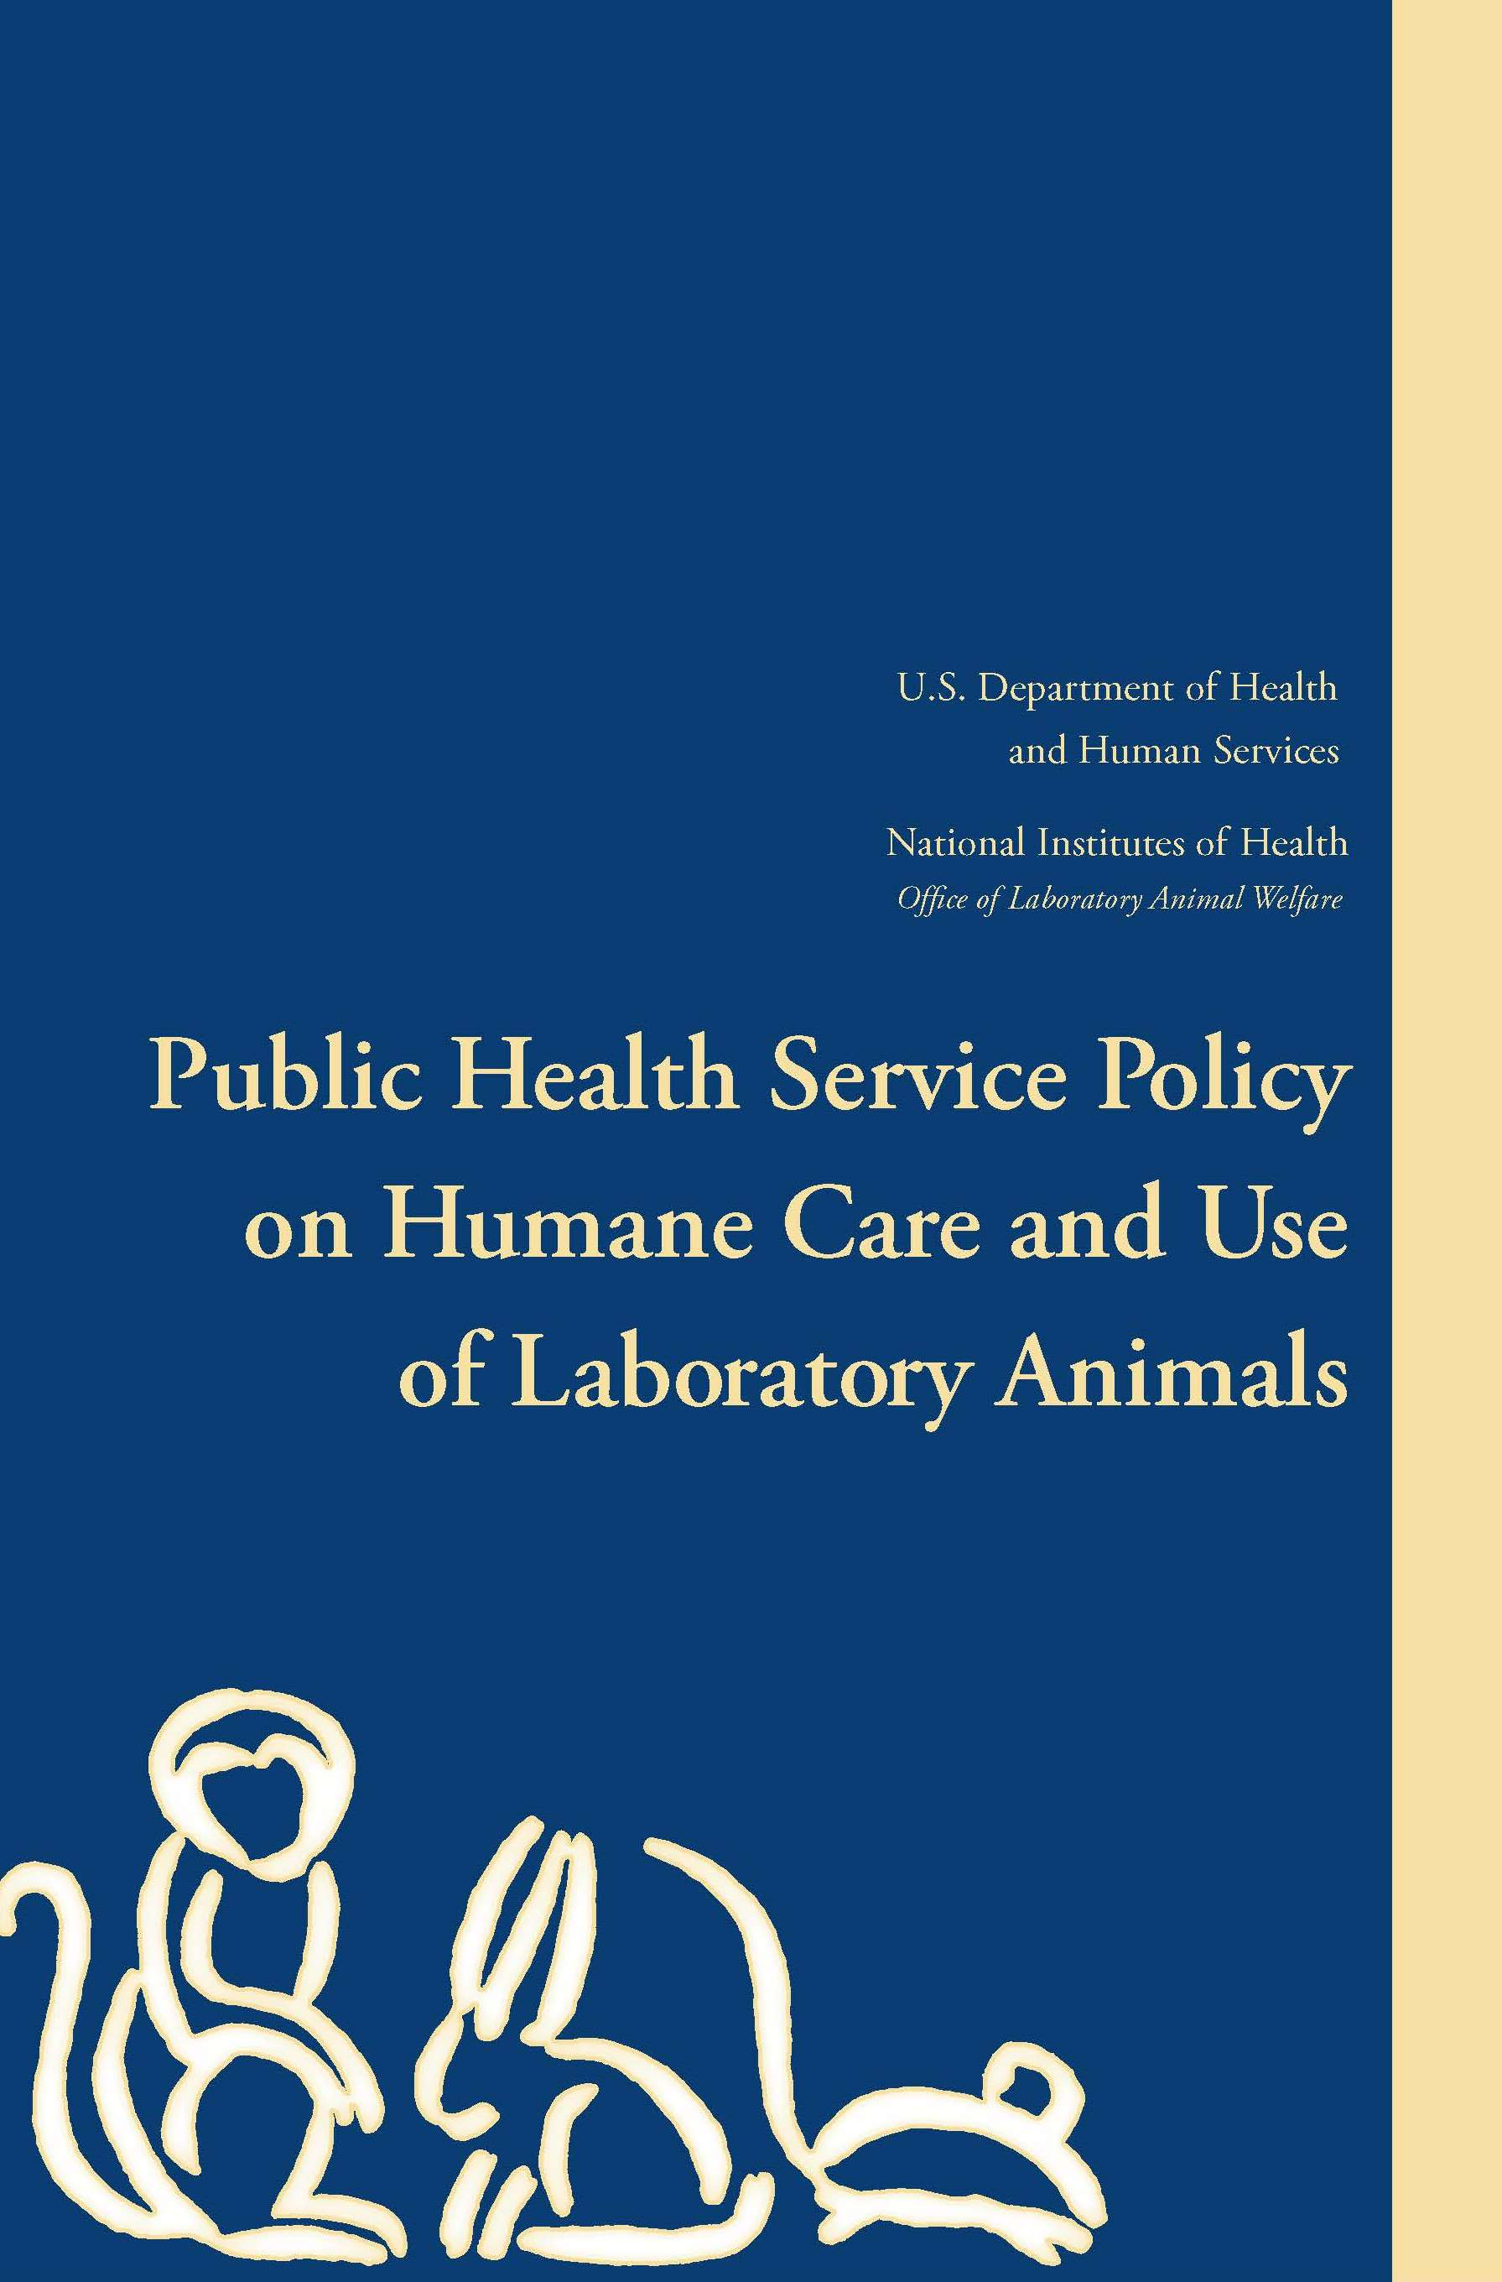
TRUE!
(click for more)
Notes:
There are federal regulations overseeing the care and use of animals in biomedical research. These are a few of the documents outlining how laboratory animals should be cared for.

Slide 15
TRUE OR FALSE?
Research involving animals only benefits humans.

Slide 16
FALSE
Notes:
Research with animals helps both humans and animals live longer, happier, and healthier lives. Vaccines, antibiotics, pain medication, preventive medication, and more help humans and animals!

Slide 17
The frequency in which laboratory animals
must be observed by care staff

Slide 18
EVERY SINGLE DAY
Notes:
The regulations require all animals to be fed, watered, and observed daily!

Slide 19
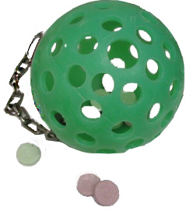
The use of this device

Slide 20
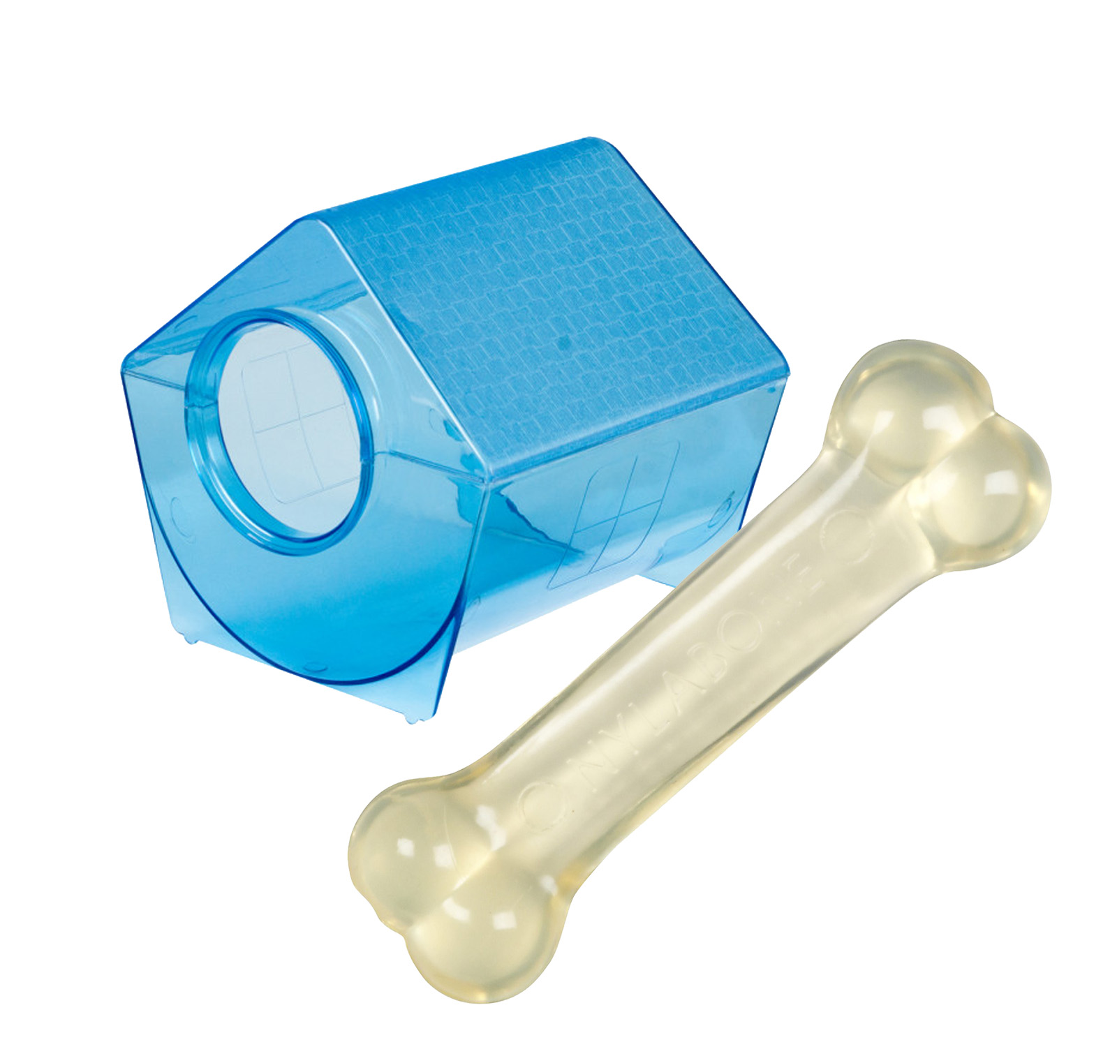
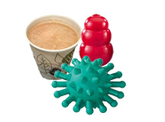
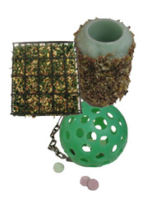
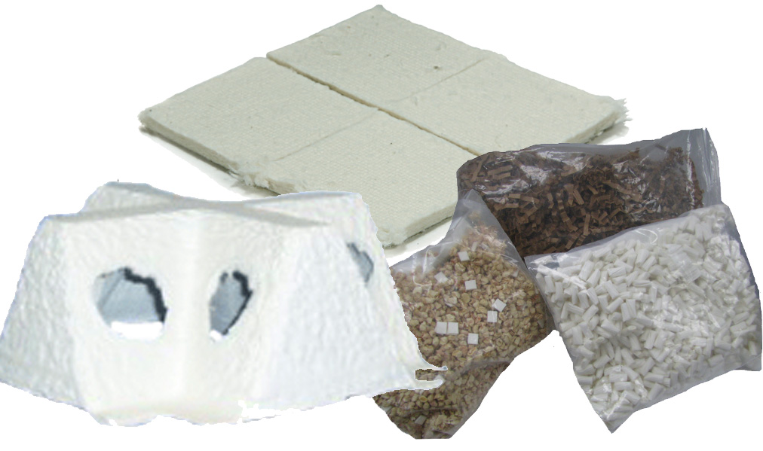
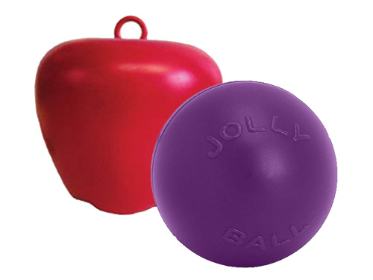
For fun and to encourage natural behaviors!
Notes:
We provide environmental enrichment to our animals to keep them happy, entertained, and stimulated.
Top left: Chinchillas - hut and chew bone
Top middle: Dogs - frozen broth with treats in it (takes awhile to get to the treats), kong, chew toy
Top right: Non-human primates – challenger ball with treats inside, foraging items, including a paint roller covered in peanut butter and seeds
Bottom left: Rodents - various huts, nesting material, and bedding
Bottom right: Pigs – items they can toss around with their snout, including giant apple and jolly ball

Slide 21
The use of this device

Slide 22
TO WATCH TV!
Notes:
Talk about providing animals with enrichment and entertainment, including TV and music.

Slide 23
Name 3 common allergens

Slide 24
POLLEN
DUSTMITES
PETS AND DANDER CIGARETTE SMOKE
Notes:
Mice are used to study allergen induced asthma, including asthma induced by these substances.

Slide 25
Alzheimers, autism,
and addiction all affect this part of the body
*HINT: it helps you think…

Slide 26
THE BRAIN
Notes:
The brain is a very complicated part of the body, and we can study different aspects of the brain in various species.

Slide 27
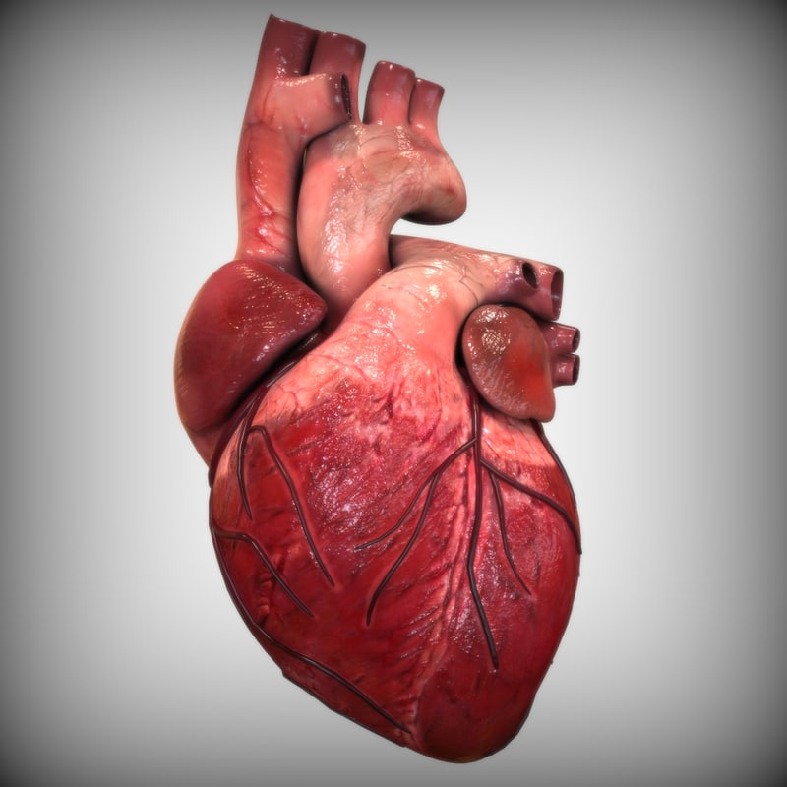
Something that can happen when this organ does not function properly

Slide 28
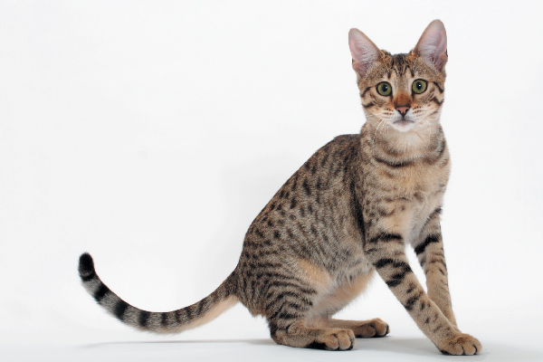
HEART ATTACK
(click for more)
Notes:
Cats can naturally develop a heart condition that can cause heart failure. We can use them to better understand why it happens and how to treat it.

Slide 29
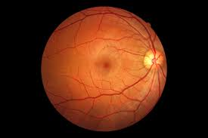
The part of the eye responsible for receiving light and converting it into a signal for the brain to interpret

Slide 30
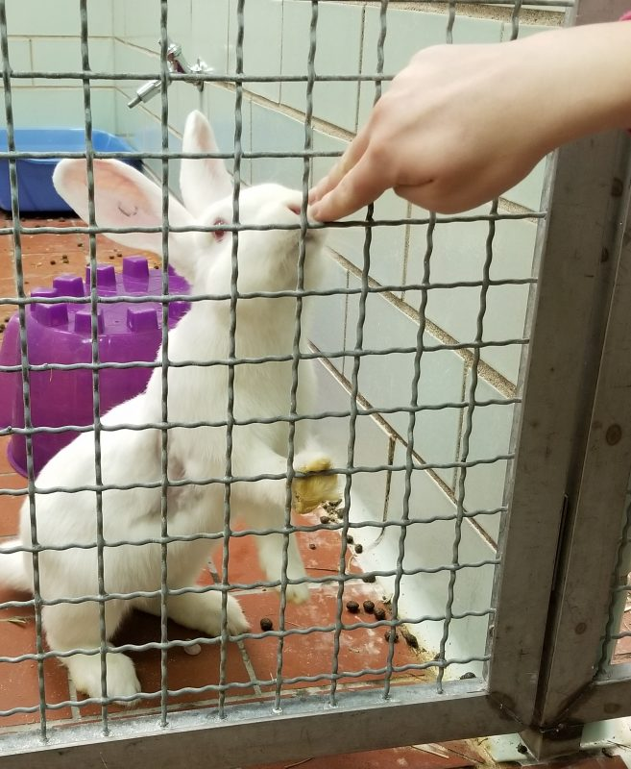
THE RETINA
(click for more)
Notes:
Rabbits are commonly used to study ocular diseases and the retina given the size of the globe. There are differences between the rabbit eye and the human eye, but many findings in the rabbit can be applied to humans.

Slide 31
Glioblastomas are tumors in this part of the body
*Hint: it's in the head!

Slide 32
THE BRAIN
(click for more)
Notes:
Glioblastomas are the most common and lethal brain tumor in adults and can cause headaches, nausea, stroke, and personality changes. These three species have been used to study this tumor and try to find treatments.

Slide 33
The term for a person who has all 4 limbs amputated

Slide 34
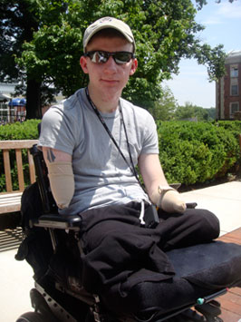
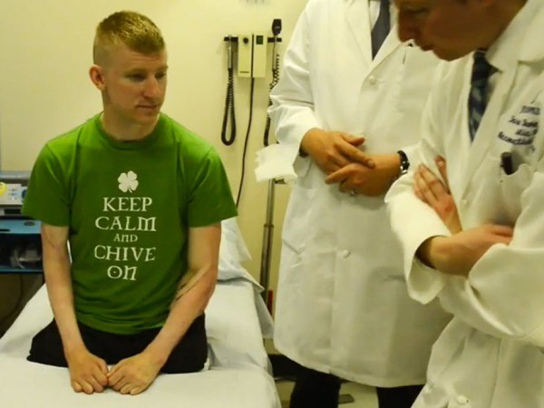
QUADRUPLE AMPUTEE
(click for more)
Brendan Marracco
Notes:
This is Brendan Marracco. He lost all 4 limbs when a bomb exploded in Iraq. Johns Hopkins University performed the first bilateral forearm transplant in the US on Brendan, completely changing his life! Click the link to see a video.

Slide 35
The drug that diabetics take to control their blood sugar level

Slide 36
INSULIN
(click for more)
Notes:
Dogs, mice, rabbits and monkeys have all been used to develop this drug as a treatment for diabetes.

Slide 37
1 in 8 women are diagnosed with this each year

Slide 38
BREAST CANCER
Notes:
Mice can be implanted with human breast cancer, and we can then study the tumors and try to find a cure

Slide 39
The virus that causes AIDS

Slide 40
Human Immunodeficiency Virus (HIV)
(click for more)
Notes:
Pigtail macaques and rhesus macaques are used to study Simian Immunodeficiency Virus (SIV) which is a lot like HIV. We hope to understand more about the disease and how to prevent and treat HIV.

Slide 41
The insect that transmits malaria

Slide 42
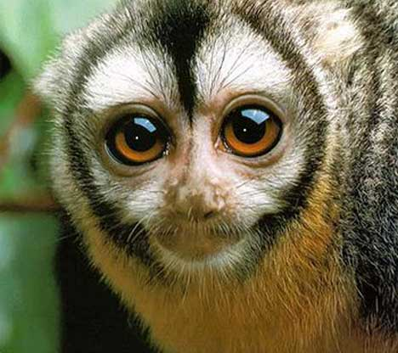
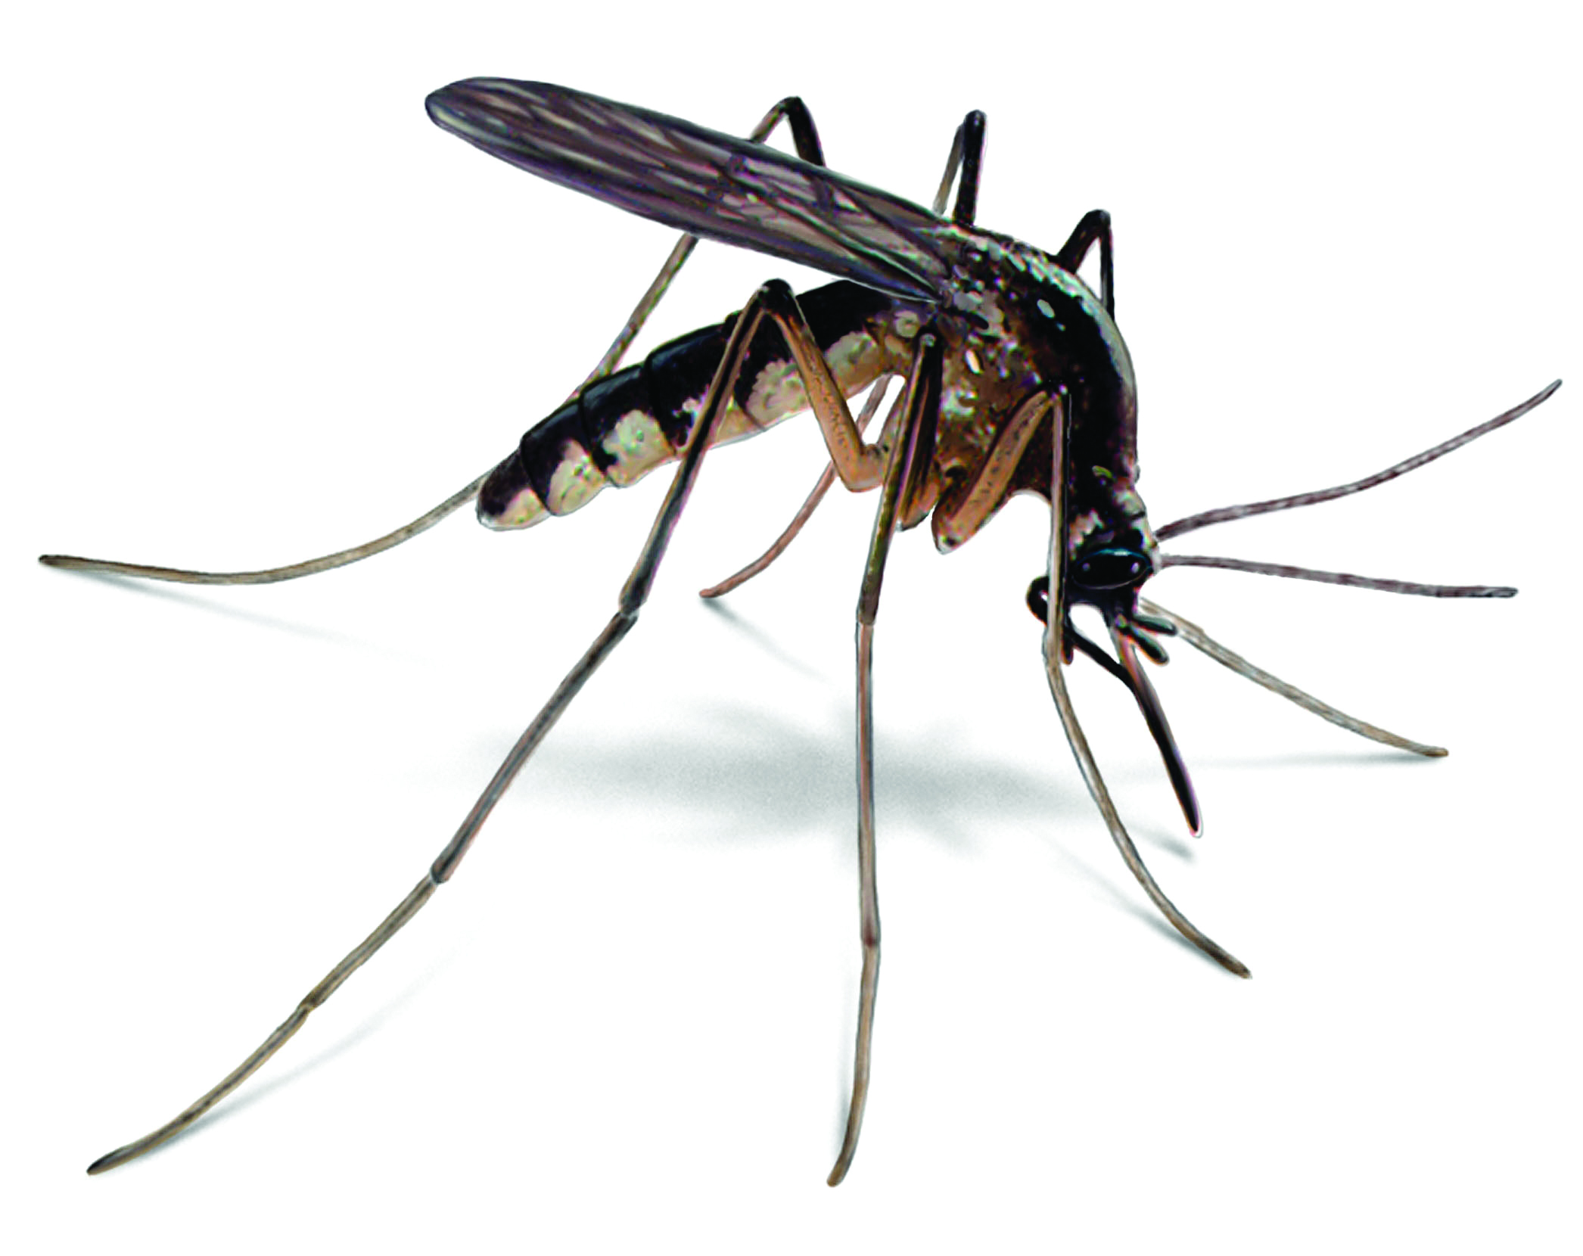
MOSQUITOES
(click for more)
Notes:
500,000 children around the world die annually due to malaria infection, a disease transmitted by mosquitoes. It is endemic in Tanzania, Uganda, and other African countries. Scientists are working to develop a vaccine to prevent malaria infection in owl monkeys and eventually, humans.

Slide 43
This species makes up less than 0.5% of the animals in research

Slide 44
DOGS
Notes:
There is a misconception that dogs are used in a lot of animal research, but in reality, most of the research is done using mice.

Slide 45
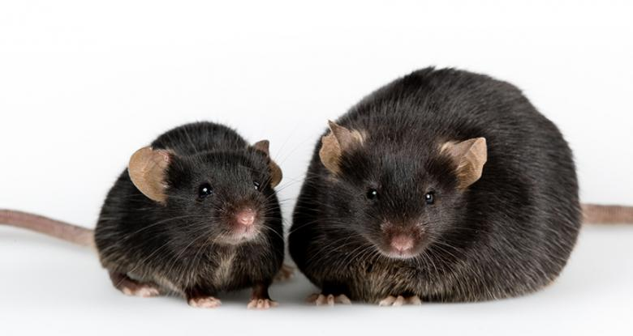
The condition that is studied in this animal

Slide 46
OBESITY
Notes:
More than 36.5% of U.S. adults are considered obese.
We can feed specific diets or change genes in these mice to make them obese and study treatment and risk factors.

Slide 47
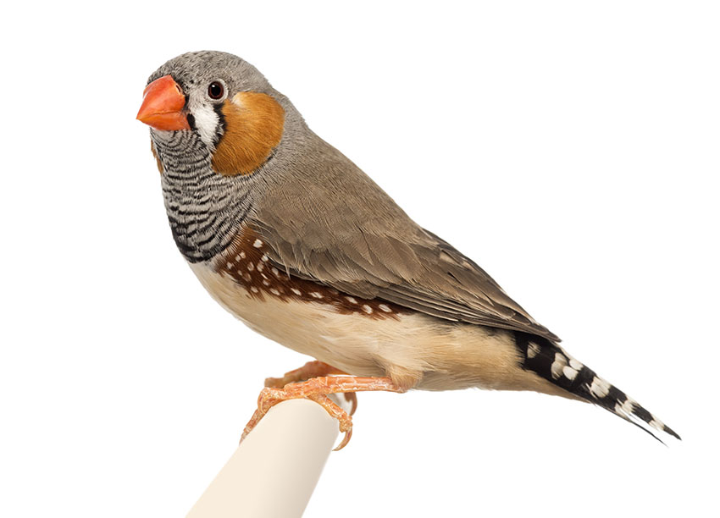
The type of research this animal is used for

Slide 48
VOCAL DEVELOPMENT AND BEHAVIOR
Notes:
Male zebrafinches develop a unique song by 3 months of age, and they can tell us a lot about behavior and development!

Slide 49
This species has blue blood and is used to detect bacterial contamination

Slide 50
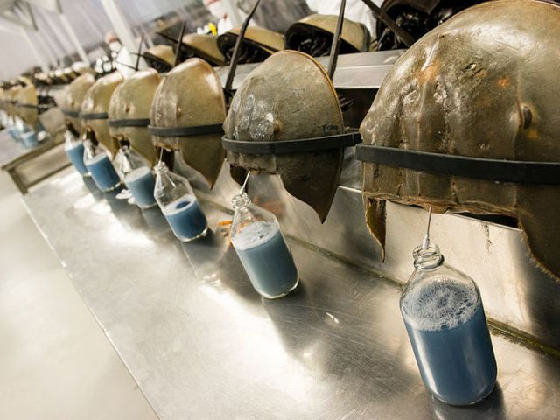
HORSESHOE CRABS
Notes:
Horseshoe crabs can be caught

Slide 51
The result of gastroparesis

Slide 52
Delayed emptying of the stomach
Notes:
This can happen in people who have Parkinson’s disease or multiple sclerosis. We can use animal models to find ways to stimulate the spinal cord and cause the stomach to contract and move food along.

