Slide 1


Enrichment Jeopardy
An interactive questions game
Developed with the BRAD Team at the
School for Science and Math at Vanderbilt

Slide 2
OCCUPATIONAL | SENSORY | FOOD | SOCIAL | PHYSICAL
200 | 200 | 200 | 200 | 200
400 | 400 | 400 | 400 | 400
600 | 600 | 600 | 600 | 600
800 | 800 | 800 | 800 | 800
1000 | 1000 | 1000 | 1000 | 1000

Slide 3


OCCUPATIONAL: 200
A BENEFIT OF EXERCISE for ANIMALS IN RESEARCH

Slide 4
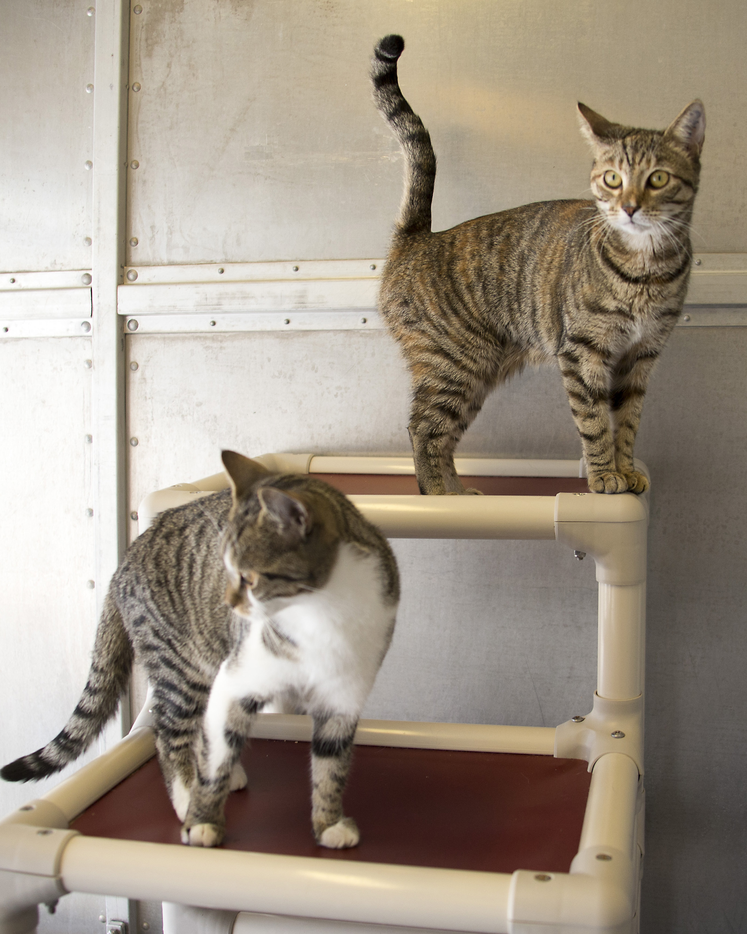
REDUCES STRESS while Improving HEALTH, MEMORY, AND
LEARNING
-

Slide 5
OCCUPATIONAL: 400
AN EXAMPLE OF ENRICHMENT USED FOR DOGS IN RESEARCH

Slide 6
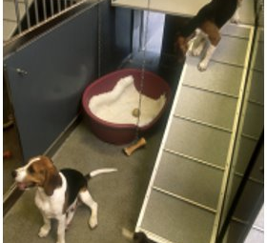
"PLAY TIME” WITH OTHER DOGS SOCIALIZATION WITH HUMANS
FOOD ENRICHMENT (TREATS)
TOYS
-

Slide 7
OCCUPATIONAL: 600
ONE WAY SCIENTISTS can PROVIDE NONHUMAN PRIMATES WITH EXERCISE

Slide 8
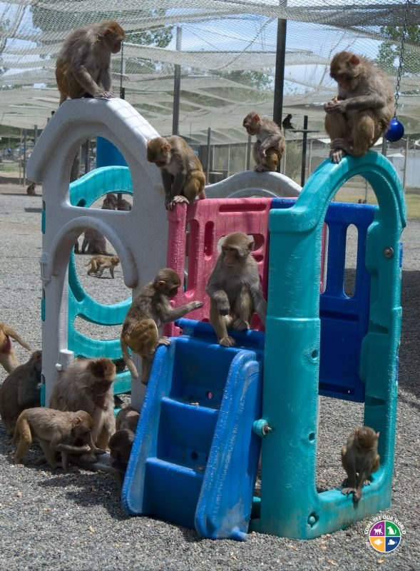
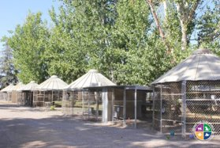
LARGE ENCLOSURES OR ACTIVITY CAGES
PLAYSCAPES
RUNNING WHEELS​
-

Slide 9
OCCUPATIONAL: 800
THE MEANING OF POSITIVE REINFORCEMENT TRAINING (PRT)​

Slide 10
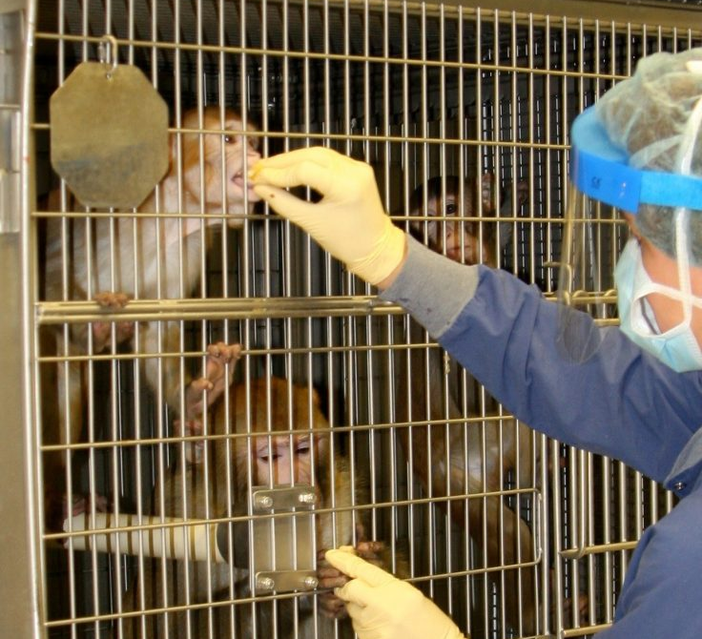
A LEARNING PROCESS WHERE ANIMALS ARE REWARDED FOR PERFORMING SPECIFIC BEHAVIORS
-

Slide 11
OCCUPATIONAL: 1000
A BENEFIT OF POSITIVE REINFORCEMENT TRAINING​

Slide 12
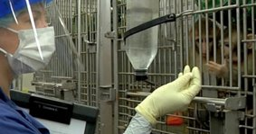
INCREASES MENTAL STIMULATION
MAKES SUBJECT SAFER TO HANDLE ​
IMPROVES ANIMAL WELFARE
DECREASES STRESS
-

Slide 13
SENSORY: 200
THE PURPOSE OF SENSORY ENRICHMENT​

Slide 14
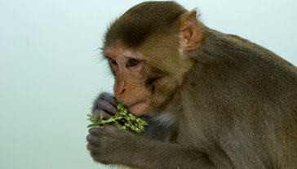
PROVIDE STIMULATION FOR ONE OR MORE OF THE SENSES ​
SMELL
TOUCH
SIGHT
TASTE
HEARING
-

Slide 15
SENSORY: 400
A TYPE OF VISUAL ENRICHMENT​

Slide 16

TELEVISION
WINDOWS
BUBBLES
PEOPLE WATCHING
MIRRORS
-

Slide 17
SENSORY: 600
A TYPE OF OLFACTORY ENRICHMENT

Slide 18

SCENTS SPRAYED OR PLACED AROUND A ROOM OR CAGE
-

Slide 19
SENSORY: 800
A TYPE OF TACTILE ENRICHMENT ​

Slide 20
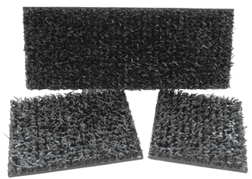
FROZEN TREATS
NESTING MATERIAL
FORAGING BOARDS
-

Slide 21
SENSORY: 1000
A TYPE OF AUDITORY ENRICHMENT

Slide 22

MUSIC
NATURE SOUNDS
HUMAN VOICES
-

Slide 23
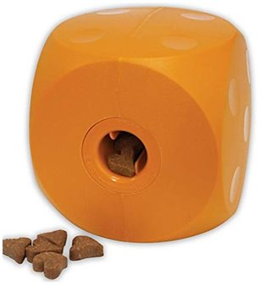
FOOD: 200
THE PURPOSE OF THIS TOY

Slide 24
FORAGING​
-

Slide 25
FOOD: 400
TRUE OR FALSE
IT IS PREFERRED TO PROVIDE TIME-CONSUMING FOOD ENRICHMENT

Slide 26
TRUE
THIS PROVIDES ANIMALS WITH A PROLONGED OPPORTUNITY TO ENGAGE WITH THE ITEM AND PERFORM SPECIES-TYPICAL BEHAVIOR
-

Slide 27
FOOD: 600
AN EXAMPLE OF A FORAGING DEVICE USED FOR NONHUMAN PRIMATES

Slide 28
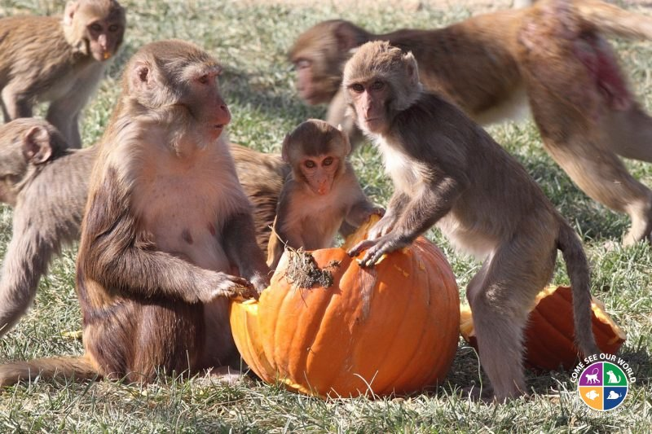
FORAGING BOARD
KONG FILLED WITH PEANUT BUTTER AND SEEDS
PAPER BAG WITH FOOD AND DESTRUCTABLE ITEMS
OTHER CREATIVE ITEMS, LIKE A PUMPKIN!
-

Slide 29
FOOD: 800
A BENEFIT OF FORAGING

Slide 30
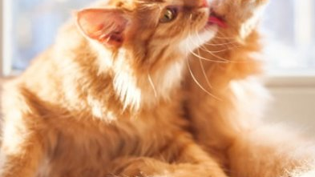
ENCOURAGES SPECIES-SPECIFIC BEHAVIOR
IMPROVES ANIMAL WELFARE
DECREASES ABNORMAL BEHAVIORS, SUCH AS OVER-GROOMING ​
-

Slide 31
FOOD: 1000
A METHOD FOR FEEDING PIGS (NOT IN A FEED BIN) THAT PROMOTES ROOTING AND FORAGING BEHAVIOR

Slide 32
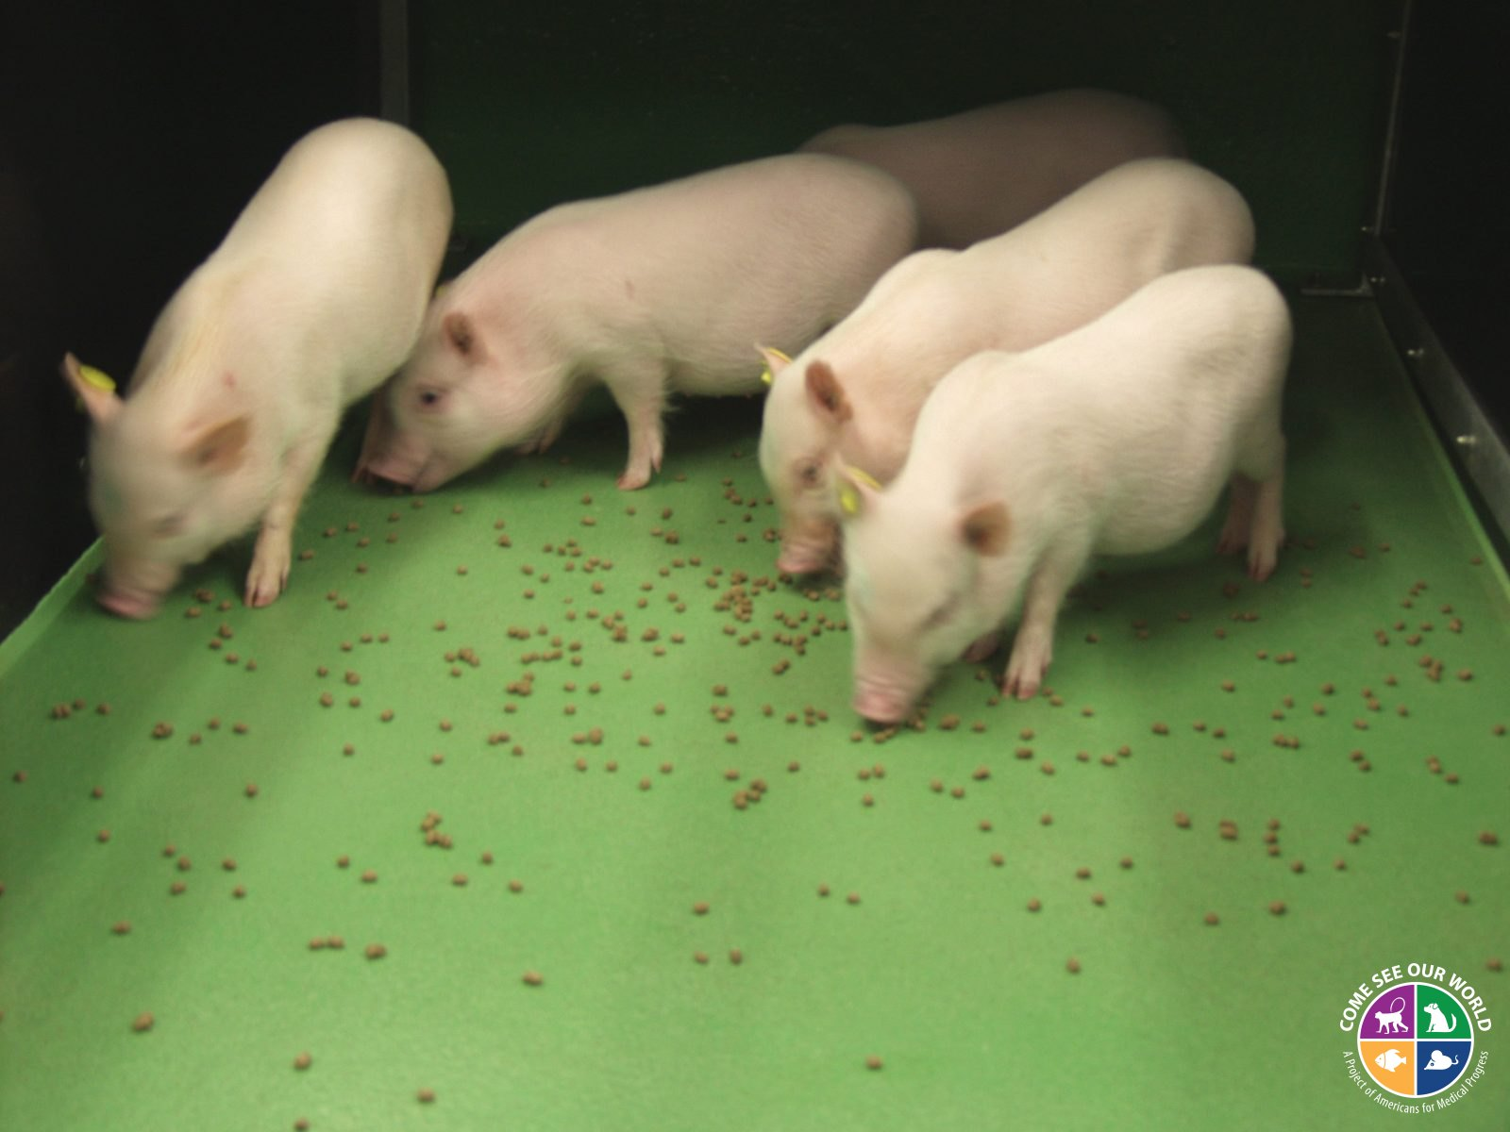
FEEDING ON THE GROUND
​
-

Slide 33
SOCIAL: 200
TRUE OR FALSE​
MOST COMMONLY USED LABORATORY ANIMALS ARE SOCIAL SPECIES, AND LIVE IN COMPLEX SOCIETIES IN THE WILD​

Slide 34
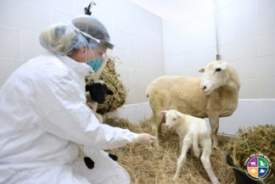
TRUE
BELOW ARE SOME OF THE MANY SPECIES THAT ARE CONSIDERED SOCIAL:
PIGS
SHEEP
DOGS
CATS
MONKEYS
MICE
RATS
CHINCHILLAS
ZEBRA FINCH
-

Slide 35
SOCIAL: 400
THE TERM MEANING ANIMALS ARE HOUSED WITH OTHER ANINALS

Slide 36
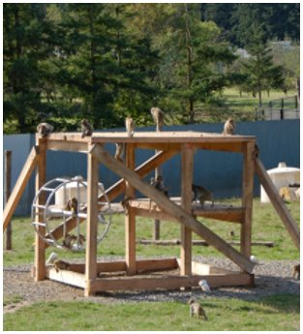
SOCIAL HOUSING
-

Slide 37
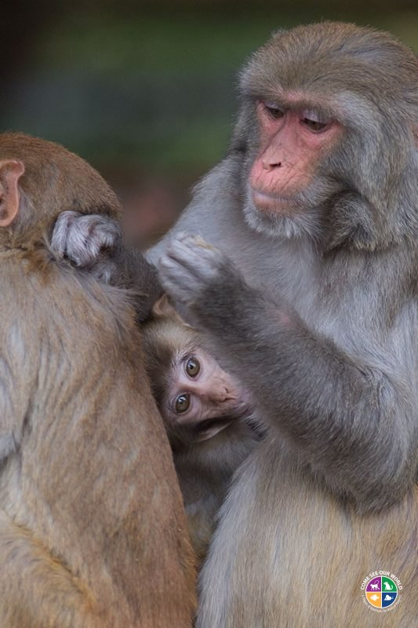
SOCIAL: 600
THE BEHAVIOR BEING DEMONSTRATED IN THIS PHOTO

Slide 38
GROOMING
-

Slide 39
SOCIAL: 800
A BENEFIT OF SOCIAL ENRICHMENT

Slide 40
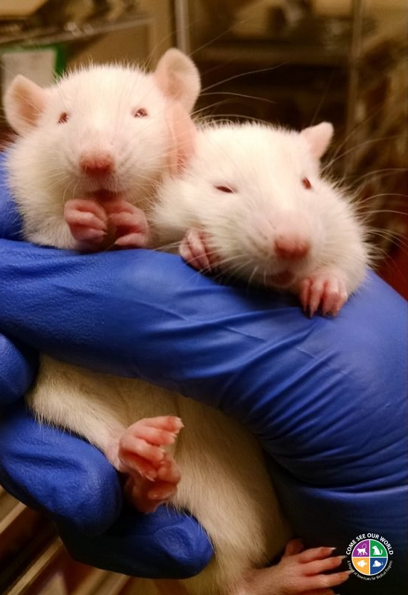
REDUCES STRESS AND ABNORMAL BEHAVIOURS
PROMOTES COPING SKILLS ​
PROVIDES MENTAL STIMULATION
ENCOURAGES PLAY
-

Slide 41
SOCIAL: 1000
CONSIDERATIONS WHEN SOCIALLY HOUSING ANIMALS

Slide 42
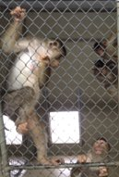
HISTORY
AGE
GENDER
WEIGHT
TEMPERAMENT
RESEARCH INVOLVEMENT
-

Slide 43
PHYSICAL: 200
AN EXAMPLE OF PHYSICAL ENRICHMENT FOR NONHUMAN PRIMATES ​

Slide 44
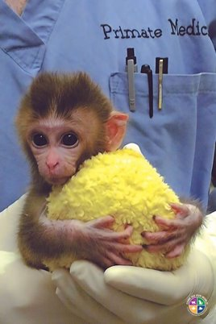
CLIMBING STRUCTURES
TOYS
SWINGS
PLAY STRUCTURES
-

Slide 45
PHYSICAL: 400
AN EXAMPLE OF PHYSICAL ENRICHMENT FOR MICE

Slide 46
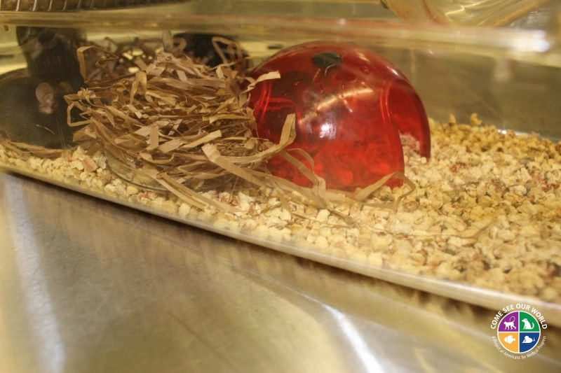
GNAWING BLOCKS
NESTING MATERIAL
HUTS
TUBES
CLIMBING STRUCTURES
-

Slide 47
PHYSICAL: 600
TRUE OR FALSE ​
THE REPORTING OF CANNIBALISM AND WOUNDING HAS INCREASED DUE TO VARIOUS FORMS OF PHYSICAL ENRICHMENT

Slide 48

FALSE
AGRESSION AND ABNORMAL BEHAVIOR TEND TO DECREASE WHEN ANIMALS ARE PROVIDED WITH PHYSICAL ENRICHMENT
-

Slide 49
PHYSICAL: 800
A GOAL OF TOYS, SUCH AS A KONG AND PIECES OF WOOD OR FLEECE

Slide 50
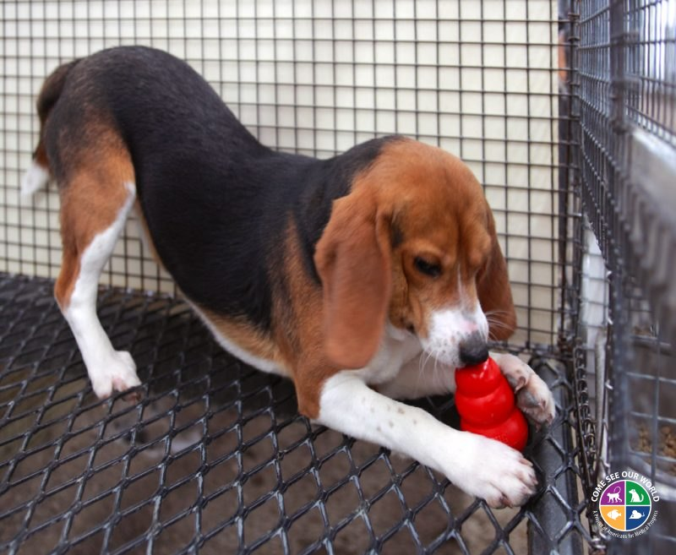
DECREASE MALADAPTIVE BEHAVIORS
ENTERTAINMENT
ENCOURAGE SPECIES-SPECIFIC BEHAVIORS
​
-

Slide 51
PHYSICAL: 1000
TRUE OR FALSE​
OUTDOOR HOUSING HAS BEEN SHOWN TO REDUCE STRESS​

Slide 52
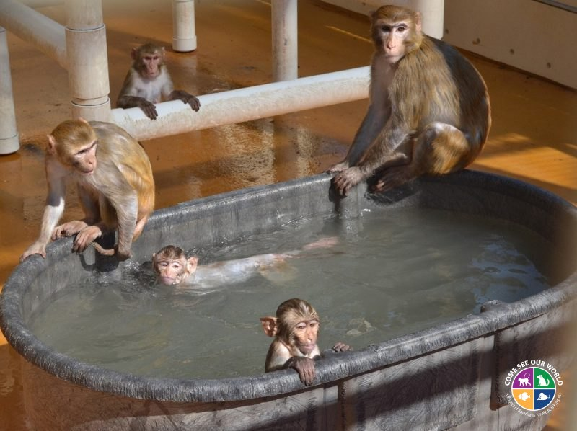
TRUE​
-

